Slide 1
Library Management System
- Anup Kulkarni

Slide 2
Objective:
The objective of this project is to store and maintain the records of a library digitally.

Slide 3
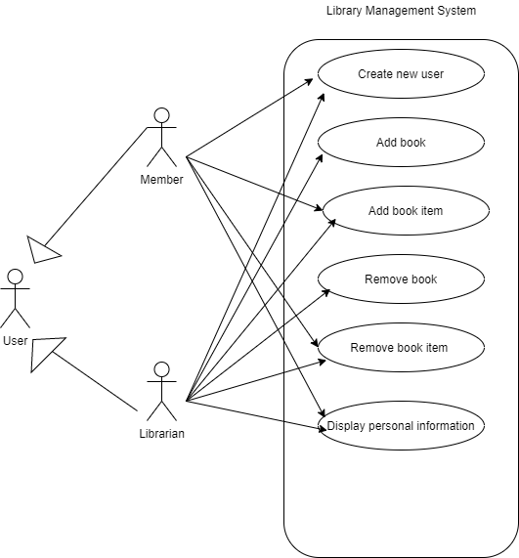
Use Case Diagram

Slide 4
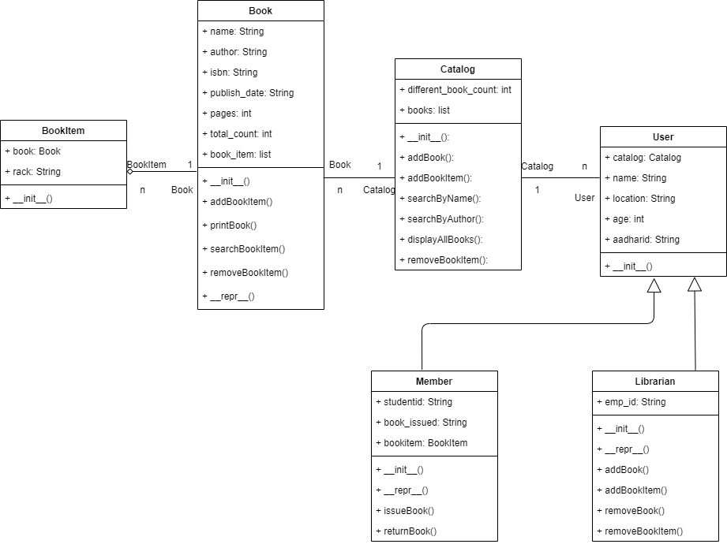
Class Diagram

Slide 5
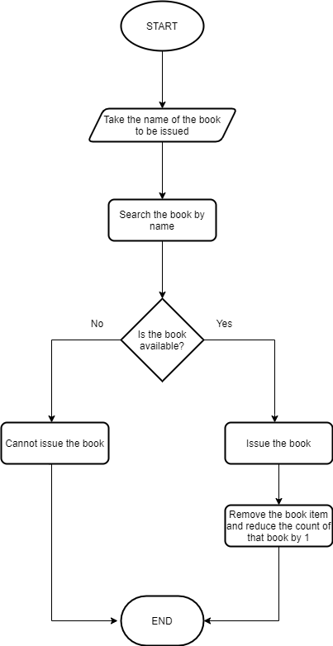
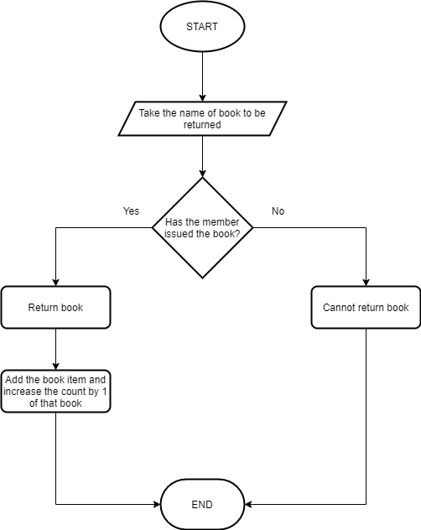
Flowcharts
Issue book flowchart
Return book flowchart

Slide 6
Thank you

